Slide 1
Chapter 05

Slide 2
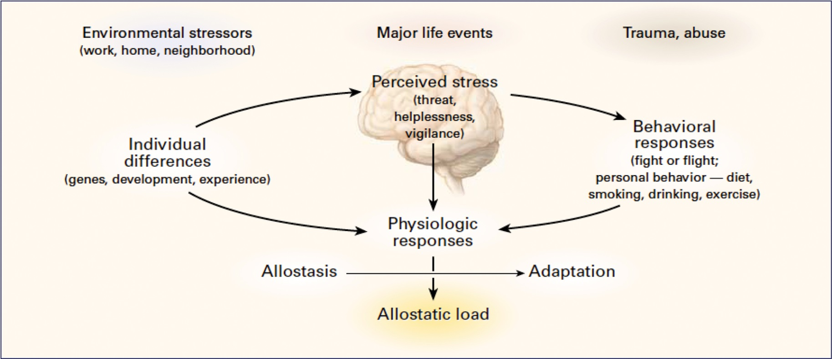
Figure 1 The stress response and development of allostatic load. The perception of stress is influenced by one's experiences, genetics, and behavior, and the social and physical environment provides the stressors that require adaptation via epigenetic processes. When the brain perceives an experience as stressful, physiologic and behavioral responses are initiated, leading to allostasis and adaptation. Over time, allostatic load can accumulate, and the overexposure to mediators of neural, endocrine, and immune stress can have adverse effects on various organ systems, including the brain, leading to disease.
From Ref. 1 by permission.

Slide 3
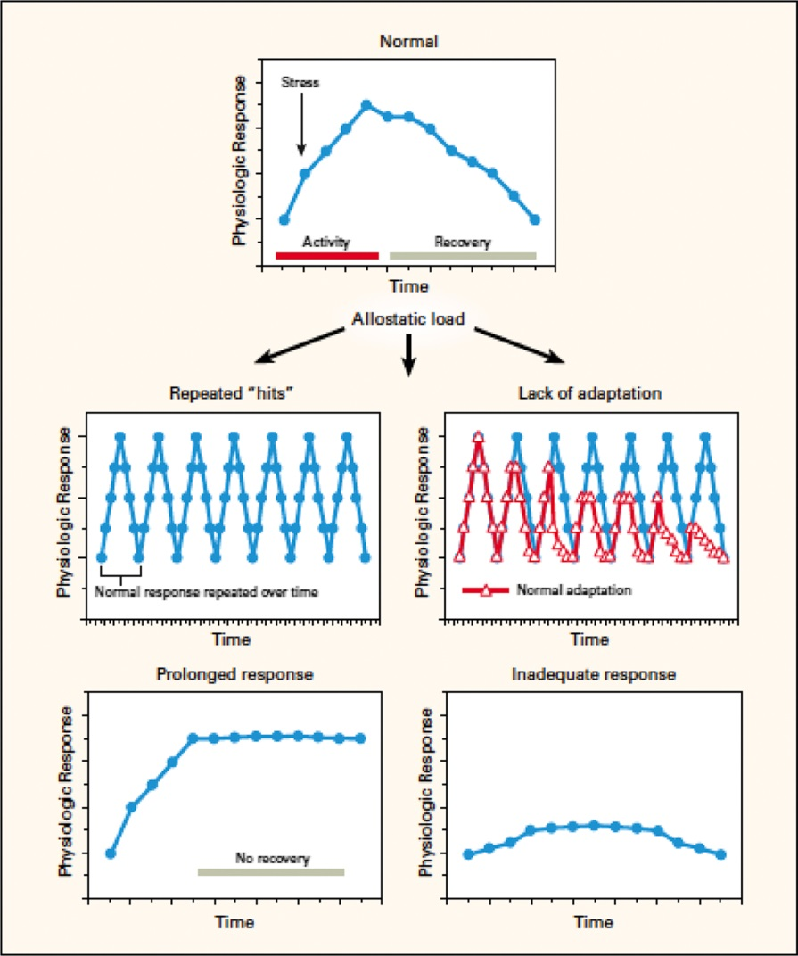
Figure 2 Three types of allostatic load. The top panel illustrates the normal allostatic response, in which a response is initiated by a stressor, sustained for an appropriate interval, and then turned off. The remaining panels illustrate four conditions that lead to allostatic load: repeated “hits” from multiple stressors; lack of adaptation; prolonged response due to delayed shutdown; and inadequate response that leads to compensatory hyperactivity of other mediators (e.g., inadequate secretion of glucocorticoids, resulting in increased concentrations of cytokines that are normally counterregulated by glucocorticoids).
From Ref. 1 by permission.

Slide 4
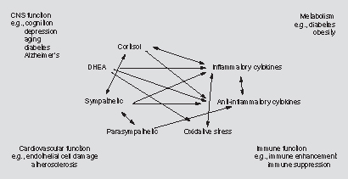
Figure 3 Nonlinear network of mediators of allostasis involved in the stress response. Arrows indicate that each system regulates the others in a reciprocal manner, creating a nonlinear network. Moreover, there are multiple pathways for regulation—e.g., inflammatory cytokine production is negatively regulated via anti-inflammatory cytokines as well as via parasympathetic and glucocorticoid pathways, whereas sympathetic activity increases inflammatory cytokine production. Parasympathetic activity, in turn, restrains sympathetic activity.
From Ref. 12 by permission.

Slide 5
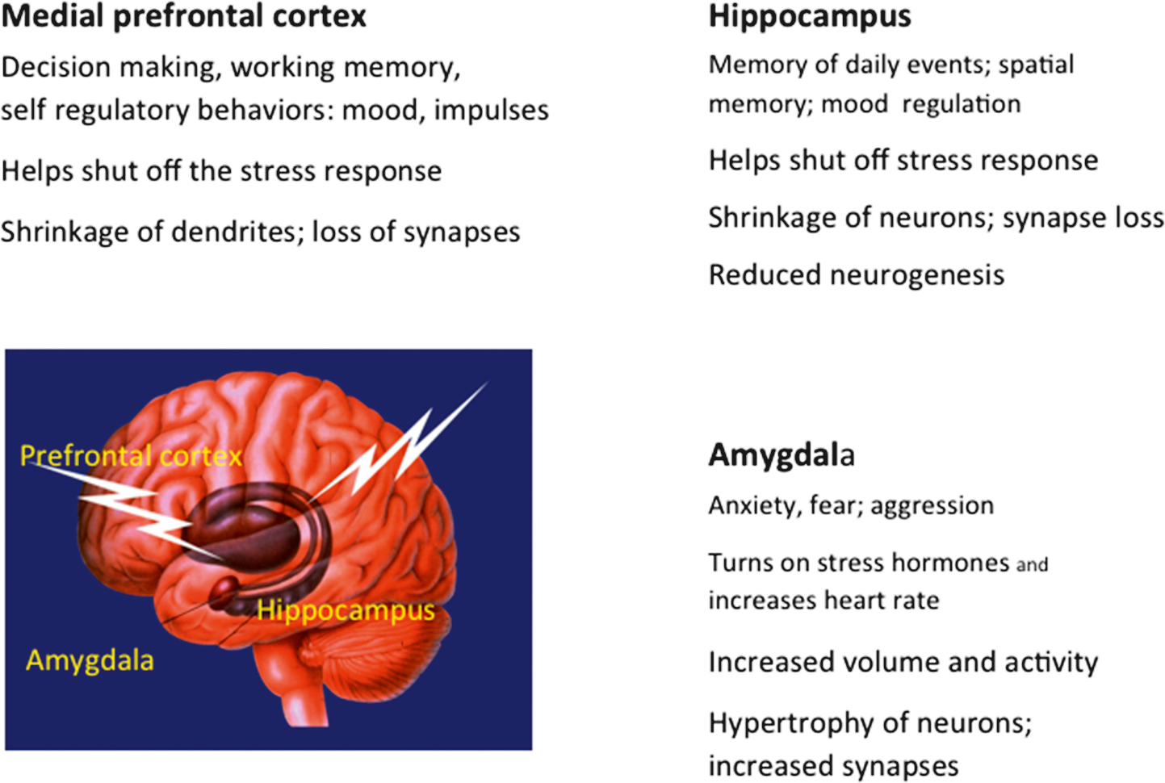
Figure 4 Three brain regions that undergo remodeling of dendrites and synapses. The hippocampus, amygdala, and prefrontal cortex communicate with each other and mediate cognitive function, fear, aggression and self-regulation, as well as turning on and off the autonomic and HPA response to stressors.

Slide 6
Figure 5 “Epigenetics” in its present definition refers to mechanisms for regulation of gene expression that do not change the genetic code.¹⁰ Transposons and retrotransposons are somewhat of an exception in that pieces of DNA are removed and inserted into other locations “jumping genes.”¹⁰⁵

